Slide 1
Joint UN Yemen technical workshop on rehabilitation and correction
Central prisons in Yemen: Assessment of the conditions
(children)
7-8 November 2018
Amman, Jordan
www.penalreform.org

Slide 2
Children accompanying their mothers
According to Yemeni prison law, children are allowed to stay with their mothers in detention till the age of two years [Art. (28) of prisons law No.48 for 1991]. After the two years, the child should be handed to his father or legal guardians. While Art. (29) of the same law states that if there are no guardians to whom the child can be handed, the child should be placed in one of the care centers run by the government within the same governorate where the prison is located. The same article of the law gives the right to the Minister of Interior to decide in certain circumstance to keep the child with his/her mother when he/she is older than 2 years.
www.penalreform.org

Slide 3
Children accompanying their mothers
During the assessment it was found that there are 37 children accompanying their mothers in detention between the age of 2 months to 16 years. Many of them are above the age of 2 years old. For example, in an exceptional case, it was found that there is a girl who is 16 years old and is staying with her mother at Sanaa prison.
www.penalreform.org

Slide 4
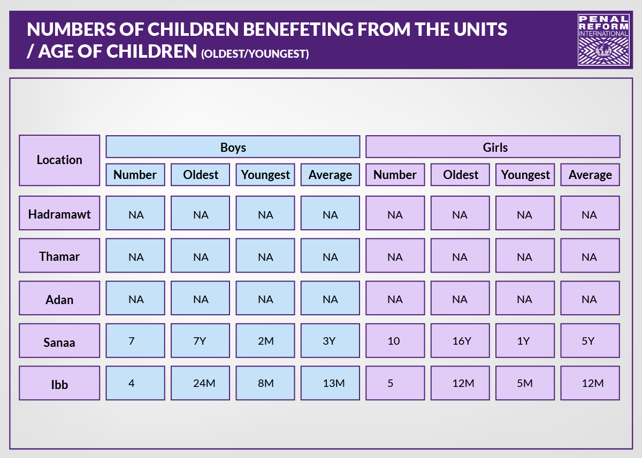
www.penalreform.org

Slide 5
Children accompanying their mothers
According to the assessment, it was found that children accompanying their mothers in detention and of school age are not enrolled in any educational programs and are living in harsh conditions. The exceptions are Al-Amanah Prison in Sanaa and Ibb Prison, where PRI has established Mothers and Babies Units which provide a good environment and takes their needs and well-being into consideration
www.penalreform.org

Slide 6
Children accompanying their mothers
It is worth mentioning that according to Article No. 29 of the prison law, the prison department is under an obligation to create child care units for these children while in detention. These units don’t exist in Mukalla, Al-Mansoura and Thamar prisons. It is highly recommended that UN Women creates such units and introduces educational programs for the children who are of school going age.
www.penalreform.org

Slide 7
Children accompanying their mothers
the assessment highlighted is the fact that 94% of those children do not have birth certificates. This is a matter that requires intervention from local NGOs and the authorities to help in providing them with official documents.
www.penalreform.org

Slide 8
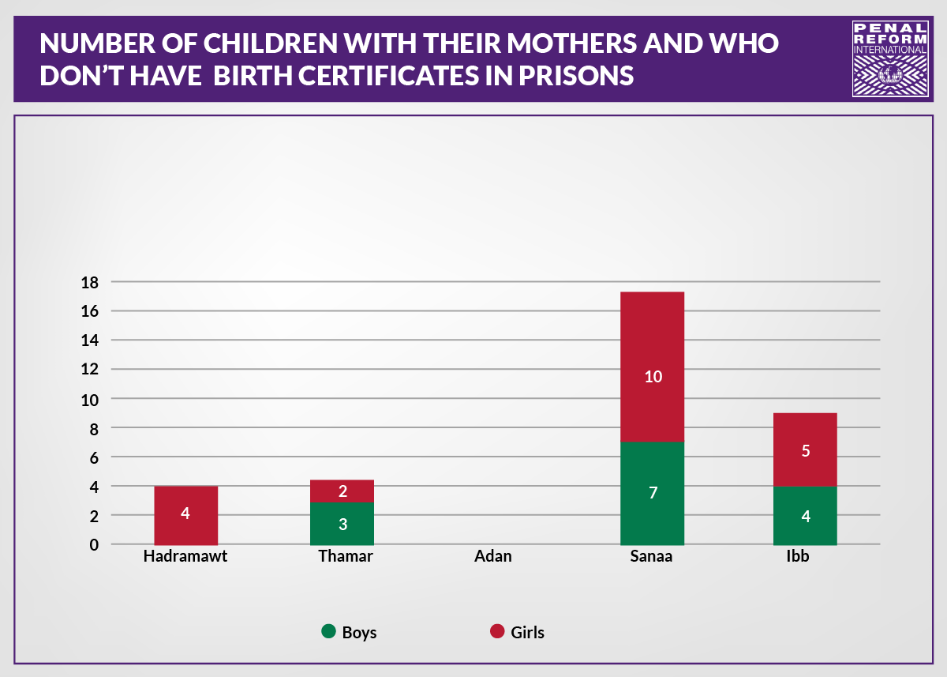
www.penalreform.org

