Slide 1
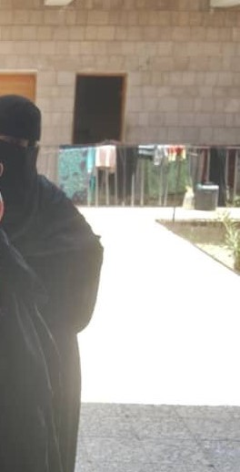
Psycho-Social & Life Needs Assessment of Yemeni Female Inmates

Slide 2
1. Assessment & Detainee Profiles
In partnership with Family Counseling and Development Foundation (FCDF), the psycho-social assessment survey was designed to identify the needs of women in detention including:
Physiological needs
Safety needs
Social belonging
Self esteem
Psychological disorders

Slide 3
Target Population
Female prisoners in:
Al-Amanah Central Prison – Sana’a
Ibb Central Prison
Dhamar Prison
Al-Mansoura Rehabilitation Centre - Aden
Mukalla Rehabilitation Centre
Only 43 women agreed to participate in the psychological and life needs assessment.
A sample of 29% from the total of 148 female prisoners in the five facilities.

Slide 4
Detainee Ages

Slide 5
Detainee Marital Status

Slide 6
Detainee Education

Slide 7
Duration of Sentence

Slide 8
2. Survey Results
The survey data was collected and analyzed by a team of psychologists.
This section presents highlights and key indicators to showcase priority interventions and services needed by female prisoners.

Slide 9
Physiological Needs

Slide 10
Safety and Security Needs
Survey Statement | Percentage of Respondents
Lack of money is something I worry about. | 75%
I have a fear of the future. | 74%
No one to go to when I need any help. | 74%
I need my family to make me feel safe. | 72%
I fear for the safety of my children in prison. | 30%
I do not feel secure in prison. | 21%
I'm being blackmailed and exploited. | 17%
There is a threat to my safety. | 16%

Slide 11
Education and Training Needs
81% of respondents do not have skill or craft to enable them to work after release.
74% do not know how to take good care of their health.
72% indicated they need some level of help to improve their reading and writing skills.
72% showed interest in continuing their interrupted education.

Slide 12
Need for Community Support

Slide 13
Need for Psychotherapy
Analysis of results indicate signs of the following symptoms among female prisoners:
Depression
Hypomania
Panic attacks and anxiety
Suicidal thoughts
Early signs of Schizophrenia
Early symptoms of Dementia
Obsessive compulsive disorder
Dissociative disorder

Slide 14
Need for Life Skills
Results indicate that female inmates would benefit from trainings to improve:
Self-confidence
Communication skills
Problem solving skills
Self-defense skills
Dealing with life pressures

Slide 15
Other Indicators
Results also indicate that the majority of female prisoners have:
Low levels of self-respect, self-esteem, and self-confidence
Lacking self-assertiveness
Absence of feeling of belonging to a group, community or family
Strong need to occupy time with activities

Slide 16
Recommendations & Priorities
Essentials – hygiene products, food, water, healthcare, clothing, bedding.
Education and vocational training programs.
Mentoring program to raise self-confidence & life skills.
Work with families to raise detainee social support.
Re-integration support including small grants for income generating projects.
Counseling and psychotherapy programs.
Entertainment activities – sports, reading materials, and channels to communicate with their families.

