Slide 1

Results Based-Reporting:
Do’s & Don’ts
Presented by: John R. Dennis
LMPTF-PBF Secretariat
United Nations Resident Coordinator Office
Monrovia, Liberia
28th October 2020
Notes:
How to use this Presentation
Use “presenter view” when showing it so you can read the notes.
Print the notes pages as a script for yourself and a handout for audiences to take away afterwards.
For a 45-minute presentation use the whole deck.
For a 5-minute presentation use only the introductory slides and the key point slides with the ½ blue background, OR only read the text on the slides, not the notes.
For a shorter presentation to an audience that already knows the history, give them a brief introduction and then skip to the slides on the four Ones, the stocktaking and the next steps.
Hide or delete any slides that aren’t relevant to your audience.

Slide 2
Outline
Understanding practical tool and tips for effective monitoring & Reporting Results
Reporting Results at Different Levels:
Activity Results
Output Results
Outcome
Impact
Do’s and Don’ts of reporting
Lessons Learned between projects
Q& A

Slide 3
Training Objective
To enhance the reporting capacity of agencies implementing LMPTF/PBF Projects

Slide 4
Practical tools and tips for effective monitoring
Understand the objective of the project which you intend to monitor;
Monitoring framework must be part of the prodoc from its inception;
Monitoring plan must be consistent with AWP
Have a checklist of what you intend to do or monitor;
Make a follow-up from inputs to outputs

Slide 5
Reporting Results at Different Levels
Area of control internal to organization
Inputs
Activities
Outputs
Planned target met
Outcome
Progress Monitoring

Slide 6
Do’s & Don’ts of Reporting
For the following examples, please indicate which of the following is the best example of results based-reporting and why?
(30 minutes exercise)

Slide 7
Do’s & Don’ts of Reporting
Gender Mainstreaming in Education Planning (MoE)
completed
The MoE five-year development plan is now based on gender-differentiated data, considers and aims to address prevailing gender bias

Slide 8
Do’s & Don’ts of Reporting
DO
Focus on Changes
DON’T
Report on Activities only

Slide 9
Do’s & Don’ts of Reporting
The Government has increasingly recognized the importance of addressing the needs of disadvantaged youth across the country. The UN, along with its partners, has contributed to effectively mobilizing political and administrative commitments producing results that include a consensus on supporting the Ministry of Youth & Sports’ key priorities for the medium-term.
The issue of youth on drugs (disadvantaged youth)and its implications have been discussed in Cabinet Meetings and the FY 2020/2021 Ministry of Youth Sports budget submission. An inter-ministerial commission has prepared a 12 point action plan for approval by the Legislature, which calls for a shifting of resources to this new priority.

Slide 10
Do’s & Don’ts of Reporting
DO
Make sure the results stand scrutiny
DON’T
Be cryptic

Slide 11
Do’s & Don’ts of Reporting
The establishment of the Ministry of Gender, Children and Social Protection is an important result for children and women of Liberia.
The Ministry of Gender, Children and Social Protection has been established. It is mandated to review the potential effects of draft national policies and/or planned programmes on gender issues, particularly children and women who have essentially been underrepresented/supported.

Slide 12
Do’s & Don’ts of Reporting
DO
Ensure the readers understand the significance of the result
DON’T
say that you are reporting on a significant result

Slide 13
Do’s & Don’ts of Reporting
A community-based conflict prevention mechanism under the XX project has been established in various areas and has proven to be effective in reducing conflict.
A key feature of the model is community based.. It was established in 20 communities in Nimba, Grand Gedeh, Sinoe and Maryland Counties. A midline survey shows that conflict was reduced from 15% to 5%. An evaluation conducted by John Dennis Peace Institute attributed a significant part of this success to the community-based interventions.

Slide 14
DO
Report how results were verified
DON’T
Sound implausible

Slide 15
Do’s & Don’ts of Reporting
The PBF Secretariat with support from LISGIS undertook a public perception survey on justice and security, the results of which raise serious concerns about safety in specific areas and will have major implications for future work in peacebuilding.
A public perception survey on justice and security was conducted in Bong, Lofa and Nimba counties by the PBF Secretariat with technical assistance from LISGIS. The findings indicated that 57% of the interviewees trusted the police in their area, while 22% said they trusted the police to some extent, and 18% indicated they did not trust the police. The survey findings were presented to Government officials, CSOs, UN and donors in August 2020.

Slide 16
Do’s & Don’ts of Reporting
DO
Report on the content of a policy, the findings of a survey, or recommendations of an evaluation, or the agreements resulting from a meeting
DON’T
Report only on the existence of a policy, the conduct of a survey, or the existence of an evaluation

Slide 17
Summary: Some Tips for better reporting
Do all the Do’s and avoid the Don’ts
Focus on Results, not processes
Telling the story: How is your project really making a difference
Use concrete examples: Most donors like examples
Be clear and frank
Explain: Don’t try to hide something
Avoid information overload: Technical details in annexes
Be transparent and detailed in accounting for the funds used

Slide 18
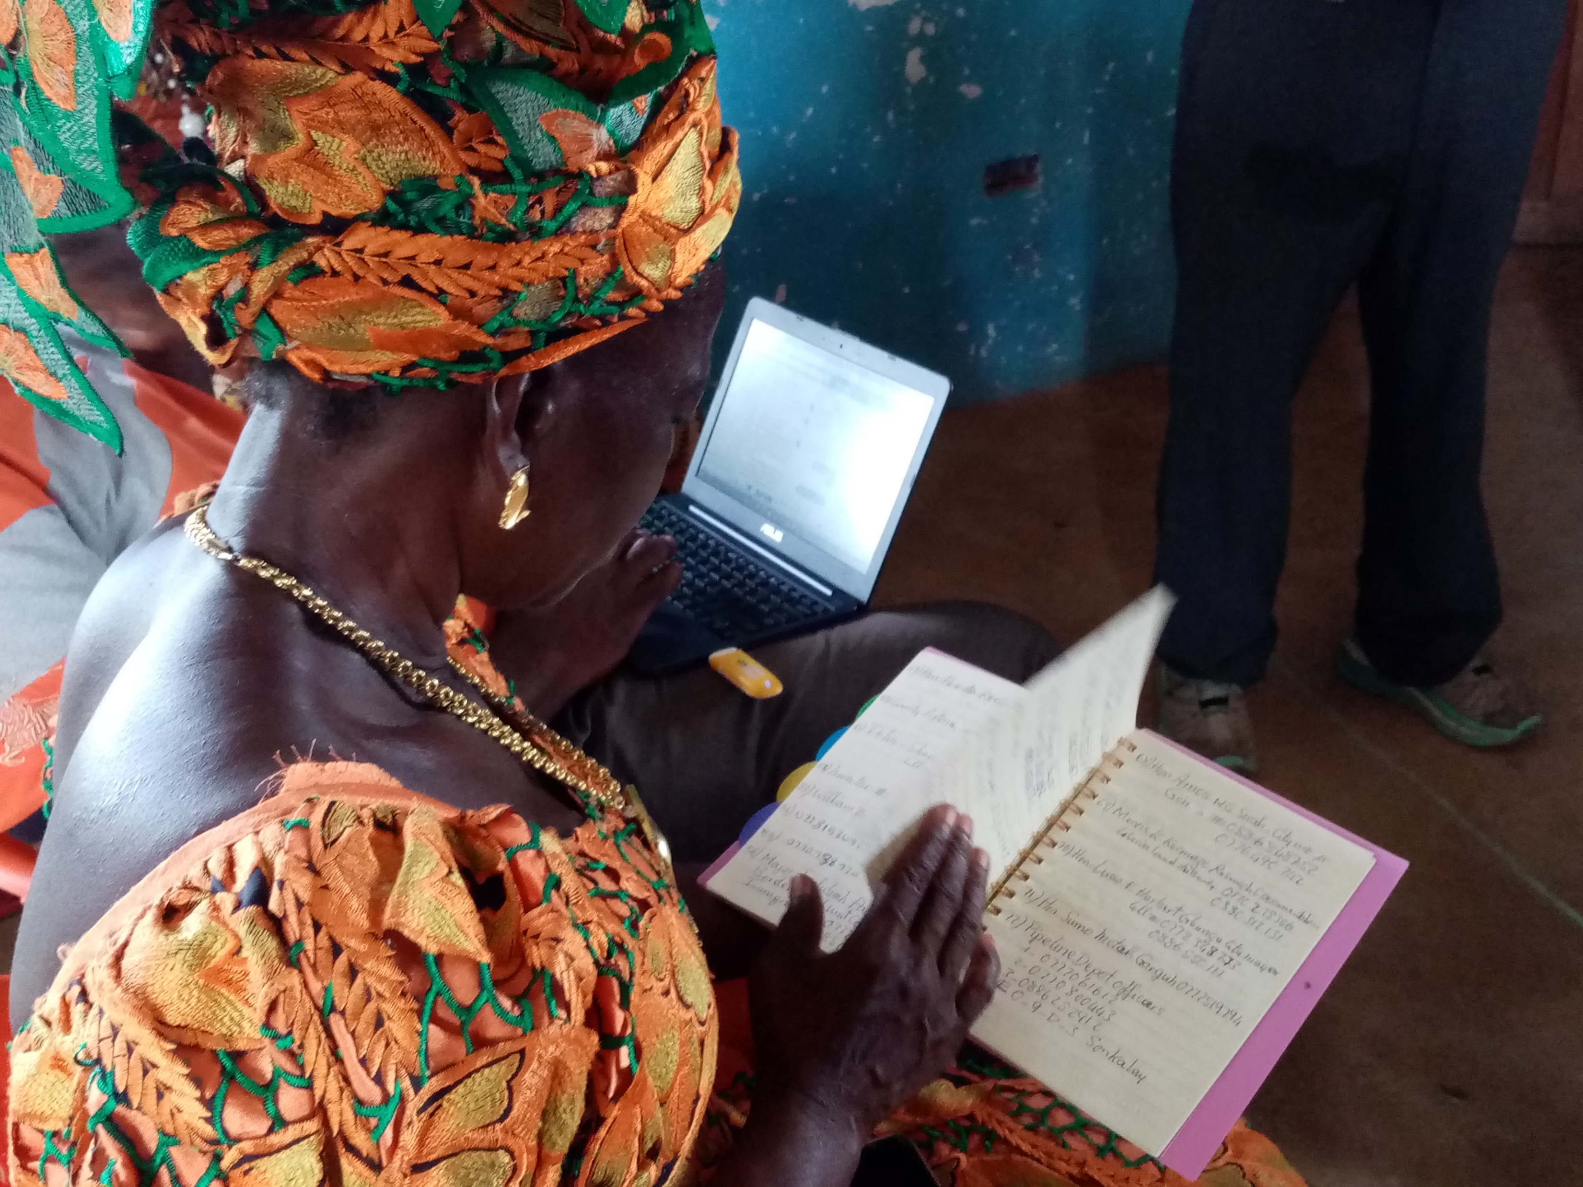
LET’S CAPTURE OUR RESULTS WELL!

Slide 19

Thank You
Notes:
How to use this Presentation
Use “presenter view” when showing it so you can read the notes.
Print the notes pages as a script for yourself and a handout for audiences to take away afterwards.
For a 45-minute presentation use the whole deck.
For a 5-minute presentation use only the introductory slides and the key point slides with the ½ blue background, OR only read the text on the slides, not the notes.
For a shorter presentation to an audience that already knows the history, give them a brief introduction and then skip to the slides on the four Ones, the stocktaking and the next steps.
Hide or delete any slides that aren’t relevant to your audience.

