Slide 1
Overview & Progress Update on the Liberia National Action Plan on Women, Peace and Security (WPS) (2019-2023) - UNSCR 1325
Presented By:
Alice Johnson-Howard
Deputy Minister for Gender
Minister of Gender, Children and Social Protection

Slide 2
Outline
Background
LNAP Phase II Roadmap
About the 2nd Phase of the LNAP
Implementation Structure of the LNAP
Achievements
Challenges
Next Steps
Conclusion

Slide 3
Background
United Nations Security Council Resolution (UNSCR) 1325 on Women, Peace and Security was adopted on 31st October 2000;
In compliance with the UNSCR 1325, Liberia adopted its first National Action Plan to implement UNSCR 1325 in 2009 (NAP 2009-2013); and
After individual stakeholders interviews and two (2) regional consultations across Liberia, the second phase of the Liberia National Action Plan (LNAP) on Women Peace and Security (WPS) was produced.
Notes:
The UN Security Council also stresses the importance of women’s equal and full participation in all efforts for the maintenance and promotion of peace and security and also calls on member states to adopt appropriate interventions for the full participation of women in the maintenance and promotion of peace and security; as well as take special measures to protect women and girls in all conflict situations in their respective countries.
The NAP spells out steps the Government of Liberia will take to support the implementation of the 1325 and recognizes the roles women played to reach the Accra’s peace agreement in 2003

Slide 4
LNAP on WPS Phase II Roadmap
October 2018 a desk review of all existing programs, projects and support on the Women, Peace and Security agenda;
National Individual stakeholders interviews and two regional consultations 2018 & 2019 (134 female and 99 male);
Consultative workshop on 28th May 2019 ( 52 participants);
High-Level Technical validation on the 9th of July 2019 (46 participants from line ministries and CSOs); and
Endorsement of the LNAP by the President and the Cabinet in November 2019.
Notes:
The 233 individuals involved during the regional consultations came from Government Agencies, CSO, women’s organizations and development partners.

Slide 5
About the 2nd Phase of the LNAP
2nd NAP WPS has five Pillars:
Prevention: Prevention of relapse into conflict and all forms of structural and physical violence against women and girls,
Protection: Women, young women and girls’ safety, physical and mental health are assured, and their human rights respected
Participation: Participation of women, young women and girls’ in all decision-making processes,
Relief and Recovery: Women and girls’ specific needs are met in relief and recovery and peacebuilding interventions,
Coordination and Accountability: Capacity and resources to coordinate, implement, monitor and report on NAP WPS implementation

Slide 6
Implementation Structure of the NAP WPS

Slide 7
Achievements
Conducted two surveys on stakeholders’ perception and knowledge on the implementation of the second NAP;
Implementation plan developed;
Implementation Structure established at the national level and in two of the 15 counties in Liberia
Notes:
The 81 persons trained include 74 civil servants (Budget and M&E officers, gender focal persons and members of the gender units) from MOJ, MFDP, MGCSP, MIA, LNP and 7 CSOs

Slide 8
Achievements Cont’d
15 master trainers from GoL & CSO on creating awareness on NAP WPS;
196 members of the implementation Structure with enhanced capacity to implement, monitor and report on NAP WPS;
2 regional consultations with 0ver 437 from Government Agencies, CSO, women’s organizations and development partners consulted;
Drafted the National Strategy for Innovative financing to support NAP implementation
Notes:
Trained 81 members of the Technical Working Group and M & E Learning Unit in results-based management (RBM) in December 2020 to monitor and report on NAP implementation
In February 2021 15 members of the NAP Implementation Structure were trained as trainers on the use of the Training Manual on Gender, Masculinity and raising Awareness on the NAP implementation.
55 members of the NAP IS (30 TWG members and 25 MEL members) and 50 members of the County taskforce (25 in grand Bassa and 25 in Nimba counties) of the NAP Implementation Structure were also trained on Gender, Masculinity and raising Awareness on the NAP implementation.

Slide 9
Challenges
Focal points from line ministries and agencies as well as civil society organizations for the implementation structure membership;
Limited Budget Allocation for the Implementation of NAP WPS; and

Slide 10
Next Steps
Approval of and support for NAP Midterm review scheduled in 2021 deadline being Dec. 31; and
Conduct a Donor conference for resource mobilization

Slide 11
Conclusion
A strong political leadership from NSC members is crucial to operationalize and enforce the NAP-WPS implementation;
Allocation of financial resources from the National Budget is imperative for the full implementation of the LNAP WPS (2019-2023);
Only UN Women is supporting the second NAP implementation;

Slide 12
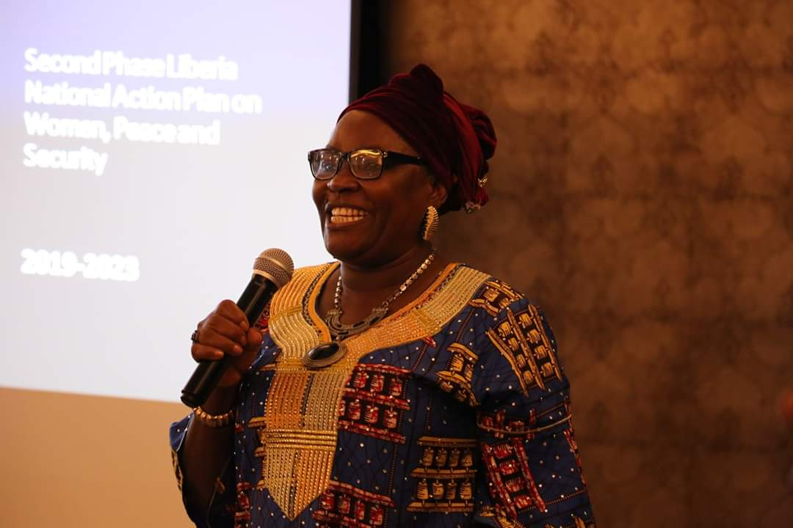
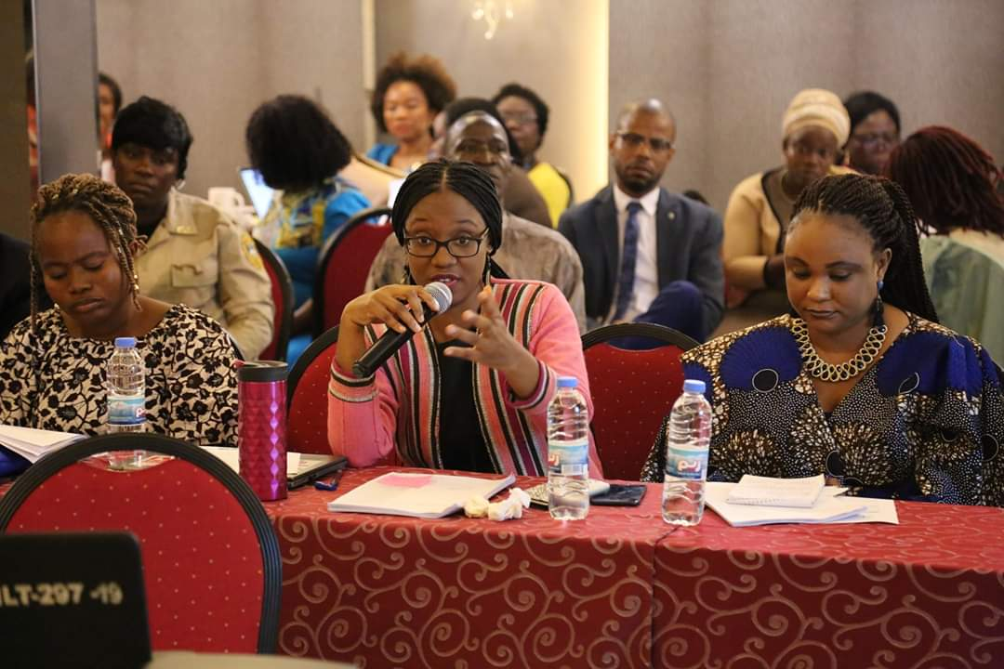
Thank you!

